Slide 1
Missing data And Bias
J. M. Nissen Consulting
Jayson Nissen, Robin Donatello, and Ben Van Dusen
she/her/hers

Slide 2
Disclaimer
The prior research in Physics Education, and the idea behind this paper came from Ben Van Dusen (Chico State Sci. Ed) and Jayson Nissen
I contributed as the ‘missing data statistical expert’
These slides were created by Jayson Nissen, remixed and used with permission, but the narrative overlay and side tangents are mine.

Slide 3
A Nation at Risk [1]
1983
The Reagan Administration
Failing American schools

Slide 4
A Nation at Risk [1]
1983
The Reagan Administration
Failing American schools
Math
SAT Score
Verbal
Dramatic drop in SAT scores
Time

Slide 5
The Sandia report and US achievement: An assessment (1994) [1]
Scientist at Sandia National Laboratory
Reanalyzed the data
Separated students into 5 performance groups
SAT Score
Time
Notes:
Make a gradient in th e arrrows to make it visually clear that participation rate is increasing in the lower quintiles

Slide 6
The Sandia report and US achievement: An assessment (1994) [1]
No change over time
Notes:
Make a gradient in th e arrrows to make it visually clear that participation rate is increasing in the lower quintiles

Slide 7
The Sandia report and US achievement: An assessment (1994) [1]
Scientist at Sandia National Laboratory
Reanalyzed the data
Separated students into 5 performance groups
SAT Score
No change over time
More students took the SAT
Simpsons Paradox (subgroup behavior does not match combined group behavior)
Time
Notes:
Make a gradient in th e arrrows to make it visually clear that participation rate is increasing in the lower quintiles

Slide 8
Motivation
Science for good or bad shapes policy and impacts lives
Science is only as reliable as the methods we employ
A Nation at Risk – 1983 vs 1994 [1]
Replication Crises – Today
Psychology, Sociology, Economics, and Biomedical
Statistical literacy for scientists is critical
Updating common practices to use the new and improved
Gaps in statistical practices in PER
Missing Data

Slide 9
PER Status Quo: Complete Case Analysis
Complete data only
Built in to most statistics software
Notes:
There seems to be this idea in PER that by only using the matched data we have addressed any problems that missing data represents.

Slide 10
PER Status Quo: Complete Case Analysis
Complete data only
Built in to most statistics software
ID | Pre | Post | Other Variables
0294 | 32 | 67 | …
7839 | NA | 54 | …
6667 | 54 | 89 | NA
3243 | 34 | NA | …
4325 | 44 | 100 | …
7658 | 68 | 88 | …
3489 | NA | NA | …
Notes:
There seems to be this idea in PER that by only using the matched data we have addressed any problems that missing data represents.

Slide 11
PER Status Quo: Complete Case Analysis
Complete data only
Built in to most statistics software
ID | Pre | Post | Other Variables
0294 | 32 | 67 | …
7839 | NA | 54 | …
6667 | 54 | 89 | NA
3243 | 34 | NA | …
4325 | 44 | 100 | …
7658 | 68 | 88 | …
3489 | NA | NA | …
Other Variables
Gender
Grade
Etc.
Notes:
There seems to be this idea in PER that by only using the matched data we have addressed any problems that missing data represents.

Slide 12
PER Status Quo: Complete Case Analysis
Complete data only
Built in to most statistics software
ID | Pre | Post | Other Variables
0294 | 32 | 67 | …
7839 | NA | 54 | …
6667 | 54 | 89 | NA
3243 | 34 | NA | …
4325 | 44 | 100 | …
7658 | 68 | 88 | …
3489 | NA | NA | …
Notes:
There seems to be this idea in PER that by only using the matched data we have addressed any problems that missing data represents.

Slide 13
PER Status Quo: Complete Case Analysis
Complete data only
Built in to most statistics software
ID | Pre | Post | Other Variables
0294 | 32 | 67 | …
7839 | NA | 54 | …
6667 | 54 | 89 | NA
3243 | 34 | NA | …
4325 | 44 | 100 | …
7658 | 68 | 88 | …
3489 | NA | NA | …
Notes:
There seems to be this idea in PER that by only using the matched data we have addressed any problems that missing data represents.

Slide 14
Complete Case Analysis
Complete data only
Built in to most statistics software
ID | Pre | Post | Other Variables
0294 | 32 | 67 | …
7839 | NA | 54 | …
6667 | 54 | 89 | NA
3243 | 34 | NA | …
4325 | 44 | 100 | …
7658 | 68 | 88 | …
3489 | NA | NA | …
ID | Pre | Post | Other Variables
0294 | 32 | 67 | …
4325 | 44 | 100 | …
7658 | 68 | 88 | …
Notes:
Adding a few words to illustrate what it means to be an assumption.

Slide 15
Complete Case Analysis
Complete data only
Built in to most statistics software
ID | Pre | Post | Other Variables
0294 | 32 | 67 | …
7839 | NA | 54 | …
6667 | 54 | 89 | NA
3243 | 34 | NA | …
4325 | 44 | 100 | …
7658 | 68 | 88 | …
3489 | NA | NA | …
ID | Pre | Post | Other Variables
0294 | 32 | 67 | …
4325 | 44 | 100 | …
7658 | 68 | 88 | …
Reliable only when data is missing completely at random (MCAR)
Notes:
Adding a few words to illustrate what it means to be an assumption.

Slide 16
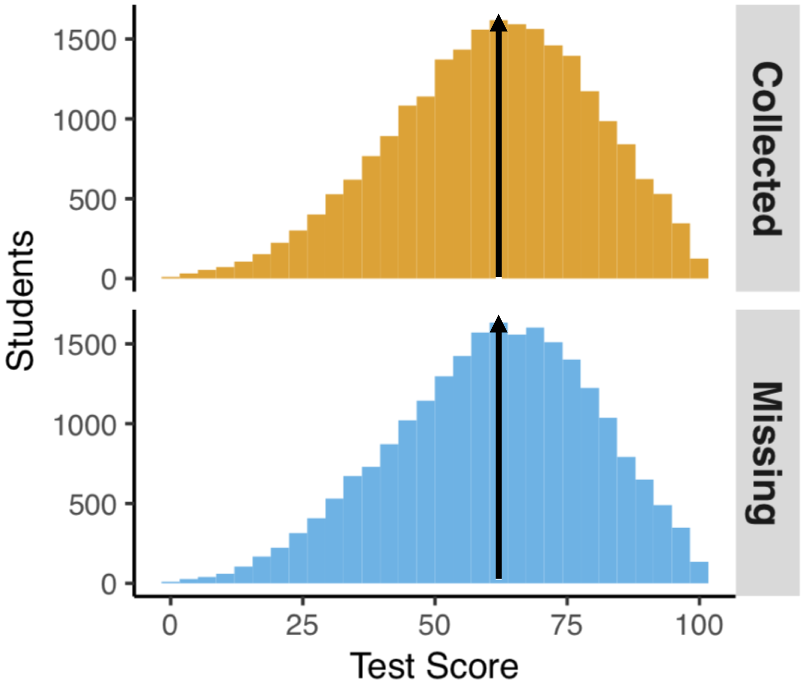
Types of missing data
Missing Completely at Random (MCAR)
The missingness is not related to the measured variable
Missing and collected data look similar

Slide 17
Types of missing data
Missing Completely at Random (MCAR)
The missingness is not related to the measured variable
Missing and collected data look similar

Slide 18
Current practices in PER Studies
28 studies
reported descriptive statistics
for pre and posttests
Notes:
Change these animations to hammer home that most didn’t provide this information.
Summarize it for them. Not MCAR because higher performing students are overrepresented

Slide 19
Current practices in PER Studies
28 studies
reported descriptive statistics
for pre and posttests
27 used complete case analysis
1 used all data
Notes:
Change these animations to hammer home that most didn’t provide this information.
Summarize it for them. Not MCAR because higher performing students are overrepresented

Slide 20
Current practices in PER Studies
28 studies
reported descriptive statistics
for pre and posttests
27 used complete case analysis
1 used all data
8 provided information about participation rates
Notes:
Change these animations to hammer home that most didn’t provide this information.
Summarize it for them. Not MCAR because higher performing students are overrepresented

Slide 21
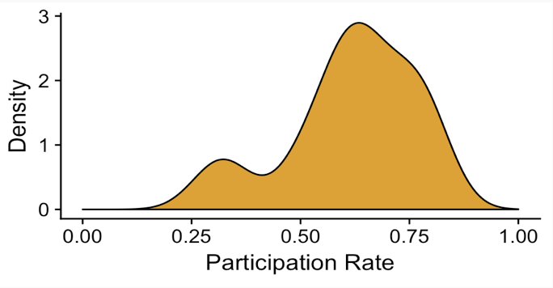
Current practices in PER Studies
28 studies
reported descriptive statistics
for pre and posttests
27 used complete case analysis
1 used all data
8 provided information about participation rates
30% to 80%
Notes:
Change these animations to hammer home that most didn’t provide this information.
Summarize it for them. Not MCAR because higher performing students are overrepresented

Slide 22
Current practices in PER Studies
28 studies
reported descriptive statistics
for pre and posttests
27 used complete case analysis
1 used all data
8 provided information about participation rates
30% to 80%
3 provided grade data
Moderate to large difference
B- for participants
C for nonparticipants
Notes:
Change these animations to hammer home that most didn’t provide this information.
Summarize it for them. Not MCAR because higher performing students are overrepresented

Slide 23
Current practices in PER Studies
28 studies
reported descriptive statistics
for pre and posttests
27 used complete case analysis
1 used all data
8 provided information about participation rates
30% to 80%
3 provided grade data
Moderate to large difference
B- for participants
C for nonparticipants
Not MCAR
Notes:
Change these animations to hammer home that most didn’t provide this information.
Summarize it for them. Not MCAR because higher performing students are overrepresented

Slide 24
Participation Study
Nissen, Jariwala, Close, and Van Dusen, International Journal of STEM Education, 2018
Compared participation on computer based and paper based tests
Notes:
Keep iin mind that for complete case analysis missing posttest data means that that student is removed from the analysis
Tie this back to the nation at risk. Just like in the nation at risk report we aren’t accounting for who is participating. We run the risk that we are only measuring A and B students and we are rewarding ignoring students who do not excel.

Slide 25
Participation Study
Nissen, Jariwala, Close, and Van Dusen, International Journal of STEM Education, 2018
Compared participation on computer based and paper based tests
Grade predicted participation
Statistically significant
Meaningful
Notes:
Keep iin mind that for complete case analysis missing posttest data means that that student is removed from the analysis
Tie this back to the nation at risk. Just like in the nation at risk report we aren’t accounting for who is participating. We run the risk that we are only measuring A and B students and we are rewarding ignoring students who do not excel.

Slide 26
Participation Study
Nissen, Jariwala, Close, and Van Dusen, International Journal of STEM Education, 2018
Computer
Paper
Compared participation on computer based and paper based tests
Grade predicted participation
Statistically significant
Meaningful
Notes:
Keep iin mind that for complete case analysis missing posttest data means that that student is removed from the analysis
Tie this back to the nation at risk. Just like in the nation at risk report we aren’t accounting for who is participating. We run the risk that we are only measuring A and B students and we are rewarding ignoring students who do not excel.

Slide 27
Participation Study
Nissen, Jariwala, Close, and Van Dusen, International Journal of STEM Education, 2018
Computer
Paper
Compared participation on computer based and paper based tests
Grade predicted participation
Statistically significant
Meaningful
Notes:
Keep iin mind that for complete case analysis missing posttest data means that that student is removed from the analysis
Tie this back to the nation at risk. Just like in the nation at risk report we aren’t accounting for who is participating. We run the risk that we are only measuring A and B students and we are rewarding ignoring students who do not excel.

Slide 28
Participation Study
Nissen, Jariwala, Close, and Van Dusen, International Journal of STEM Education, 2018
Computer
Paper
Compared participation on computer based and paper based tests
Grade predicted participation
Statistically significant
Meaningful
Notes:
Keep iin mind that for complete case analysis missing posttest data means that that student is removed from the analysis
Tie this back to the nation at risk. Just like in the nation at risk report we aren’t accounting for who is participating. We run the risk that we are only measuring A and B students and we are rewarding ignoring students who do not excel.

Slide 29
Participation Study
Nissen, Jariwala, Close, and Van Dusen, International Journal of STEM Education, 2018
Computer
Paper
Compared participation on computer based and paper based tests
Grade predicted participation
Statistically significant
Meaningful
Notes:
Keep iin mind that for complete case analysis missing posttest data means that that student is removed from the analysis
Tie this back to the nation at risk. Just like in the nation at risk report we aren’t accounting for who is participating. We run the risk that we are only measuring A and B students and we are rewarding ignoring students who do not excel.

Slide 30
Participation Study
Nissen, Jariwala, Close, and Van Dusen, International Journal of STEM Education, 2018
Computer
Paper
Compared participation on computer based and paper based tests
Not MCAR
Grade predicted participation
Statistically significant
Meaningful
Notes:
Keep iin mind that for complete case analysis missing posttest data means that that student is removed from the analysis
Tie this back to the nation at risk. Just like in the nation at risk report we aren’t accounting for who is participating. We run the risk that we are only measuring A and B students and we are rewarding ignoring students who do not excel.

Slide 31
Purpose
Does complete case analysis bias results?
Is there a better method?

Slide 32
Types of missing data
Missing Completely at Random (MCAR)
The missingness is not related to the measured variable
Missing at random (MAR)
The missingness is related to the measured variable but is conditional on other variables
Not Missing At Random (NMAR)
The missingness is related to the measured variable

Slide 33
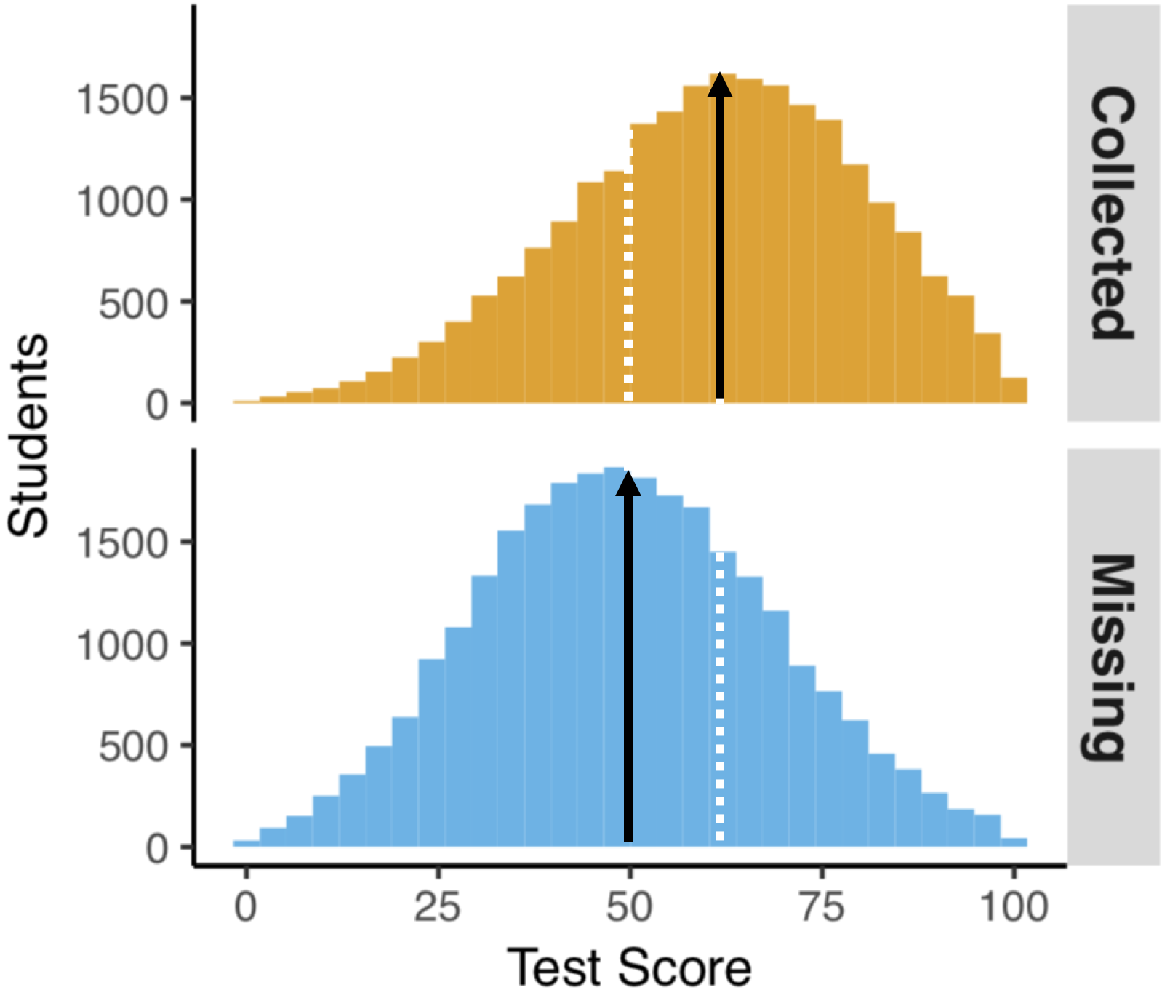
Types of missing data
Missing Completely at Random (MCAR)
The missingness is not related to the measured variable
Missing at random (MAR)
The missingness is related to the measured variable but is conditional on other variables
Not Missing At Random (NMAR)
The missingness is related to the measured variable
Notes:
Probably just delete the little graphs

Slide 34
Types of missing data
Missing Completely at Random (MCAR)
The missingness is not related to the measured variable
Missing at random (MAR)
The missingness is related to the measured variable but is conditional on other variables
Not Missing At Random (NMAR)
The missingness is related to the measured variable
Notes:
Delete these little plots

Slide 35
Explanation of MAR
Missingness is conditional on another variable
Notes:
Tie this back to the nation at risk. How the difference results from the over representation of A and B students.

Slide 36
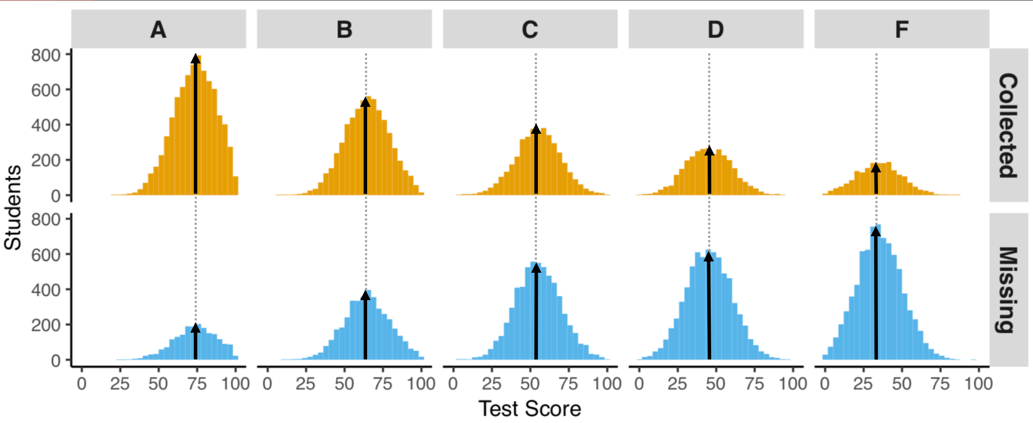
Explanation of MAR
Missingness is conditional on another variable
Assume missingness is conditional on grade
Split the data by grade
A B C D F
Notes:
Tie this back to the nation at risk. How the difference results from the over representation of A and B students.

Slide 37
Explanation of MAR
Missingness is conditional on another variable
Assume missingness is conditional on grade
Split the data by grade
A B C D F
Notes:
Tie this back to the nation at risk. How the difference results from the over representation of A and B students.

Slide 38
Explanation of MAR
Missingness is conditional on another variable
Assume missingness is conditional on grade
Split the data by grade
A B C D F
Notes:
Tie this back to the nation at risk. How the difference results from the over representation of A and B students.

Slide 39
Explanation of MAR
Missingness is conditional on another variable
Assume missingness is conditional on grade
Split the data by grade
A B C D F
Notes:
Tie this back to the nation at risk. How the difference results from the over representation of A and B students.

Slide 40
What should be done?
Impute missing data using a technique called
Multiple Imputation
Impute = “Fill in”

Slide 41
Multiple Imputation (MI) [5]
Assumptions
No inherent
Defaults in most software assumes MAR
Notes:
Each imputation has plausible scores for each student. Variability is introduced between imputation based on the information available

Slide 42
Multiple Imputation (MI) [5]
Assumptions
No inherent
Defaults in most software assumes MAR
Advantages
Extremely well validated
Uses all available data
More accurate and more precise than complete case analysis
[6 & 7]
Notes:
Each imputation has plausible scores for each student. Variability is introduced between imputation based on the information available

Slide 43
Multiple Imputation (MI) [5]
Assumptions
No inherent
Defaults in most software assumes MAR
Missing
Data
Advantages
Extremely well validated
Uses all available data
More accurate and more precise than complete case analysis
[6 & 7]
Incomplete
Data
Notes:
Each imputation has plausible scores for each student. Variability is introduced between imputation based on the information available

Slide 44
Multiple Imputation (MI) [5]
Assumptions
No inherent
Defaults in most software assumes MAR
Imputed
Data
Missing
Data
Advantages
Extremely well validated
Uses all available data
More accurate and more precise than complete case analysis
[6 & 7]
Incomplete
Data
Imputed
Datasets
Notes:
Each imputation has plausible scores for each student. Variability is introduced between imputation based on the information available

Slide 45
Multiple Imputation (MI) [5]
Assumptions
No inherent
Defaults in most software assumes MAR
Advantages
Extremely well validated
Uses all available data
More accurate and more precise than complete case analysis
[6 & 7]
Incomplete
Data
Imputed
Datasets
Notes:
Each imputation has plausible scores for each student. Variability is introduced between imputation based on the information available

Slide 46
Multiple Imputation (MI) [5]
Assumptions
No inherent
Defaults in most software assumes MAR
Advantages
Extremely well validated
Uses all available data
More accurate and more precise than complete case analysis
[6 & 7]
Incomplete
Data
Imputed
Datasets
Analysis
Results
Notes:
Each imputation has plausible scores for each student. Variability is introduced between imputation based on the information available

Slide 47
Multiple Imputation (MI) [5]
Assumptions
No inherent
Defaults in most software assumes MAR
Advantages
Extremely well validated
Uses all available data
More accurate and more precise than complete case analysis
[6 & 7]
Incomplete
Data
Imputed
Datasets
Analysis
Results
Pooled
Results
Notes:
Each imputation has plausible scores for each student. Variability is introduced between imputation based on the information available

Slide 48
Predictive Mean Matching
Incomplete
Data
Imputed
Datasets

Slide 49
Predictive Mean Matching
ID | Pre | Post
0294 | 32 | 67
7839 | 17 | NA
6667 | 54 | 89
3243 | 34 | NA
4325 | 44 | 100
7658 | 68 | 88
3489 | 21 | NA

Slide 50
Predictive Mean Matching
ID | Pre | Post
0294 | 32 | 67
7839 | 17 | NA
6667 | 54 | 89
3243 | 34 | NA
4325 | 44 | 100
7658 | 68 | 88
3489 | 21 | NA
ID | Pre | Post
0294 | 32 | 67
6667 | 54 | 89
4325 | 44 | 100
7658 | 68 | 88
3489 | 21 | NA
7839 | 17 | NA
3243 | 34 | NA

Slide 51
Predictive Mean Matching
ID | Pre | Post
0294 | 32 | 67
7839 | 17 | NA
6667 | 54 | 89
3243 | 34 | NA
4325 | 44 | 100
7658 | 68 | 88
3489 | 21 | NA
ID | Pre | Post
0294 | 32 | 67
6667 | 54 | 89
4325 | 44 | 100
7658 | 68 | 88
3489 | 21 | NA
7839 | 17 | NA
3243 | 34 | NA
$$β$$
y
x
$$y=int+ β(x)$$

Slide 52
Predictive Mean Matching
$$y=βX+ε$$
$$y=β^{∗}X+ε$$
ID | Pre | Post
0294 | 32 | 67
7839 | 17 | NA
6667 | 54 | 89
3243 | 34 | NA
4325 | 44 | 100
7658 | 68 | 88
3489 | 21 | NA
ID | Pre | Post
0294 | 32 | 67
6667 | 54 | 89
4325 | 44 | 100
7658 | 68 | 88
3489 | 21 | NA
7839 | 17 | NA
3243 | 34 | NA
$$β$$
$$β^{∗}$$
y
y
x
x
Least squares estimates $\hat{β}, \hat{Σ}$ are obtained from complete cases
New regression coefficients are drawn from $β^{∗}\sim N(\hat{β}, \hat{Σ})$

Slide 53
Predictive Mean Matching
ID | Pre | Post
0294 | 32 | 67
6667 | 54 | 89
4325 | 44 | 100
7658 | 68 | 88
3489 | 21 | NA
7839 | 17 | NA
3243 | 34 | NA
$$β^{∗}$$
y
x
$$y=β^{∗}X+ε$$

Slide 54
Predictive Mean Matching
ID | Pre | Post
0294 | 32 | 67
6667 | 54 | 89
4325 | 44 | 100
7658 | 68 | 88
3489 | 21 | NA
7839 | 17 | NA
3243 | 34 | NA
ID | Pre | Post | Post*
0294 | 32 | 67 | 60
6667 | 54 | 89 | 94
4325 | 44 | 100 | 88
7658 | 68 | 88 | 98
3489 | 21 | NA | 42
7839 | 17 | NA | 25
3243 | 34 | NA | 62
$$β^{∗}$$
y
x
$$y=β^{∗}X+ε$$
Create predicted values $y^{∗}$ for all observations

Slide 55
Predictive Mean Matching
ID | Pre | Post
0294 | 32 | 67
6667 | 54 | 89
4325 | 44 | 100
7658 | 68 | 88
3489 | 21 | NA
7839 | 17 | NA
3243 | 34 | NA
ID | Pre | Post | Post*
0294 | 32 | 67 | 60
6667 | 54 | 89 | 94
4325 | 44 | 100 | 88
7658 | 68 | 88 | 98
3489 | 21 | NA | 42
7839 | 17 | NA | 25
3243 | 34 | NA | 62
$$β^{∗}$$
y
This is ok… but we can do better…
x
$$y=β^{∗}X+ε$$
Create predicted values $y^{∗}$ for all observations

Slide 56
Hot deck Imputation
Replace a missing value with a randomly chosen observed response from a “similar” unit.
Image from ”Handling missing rows in multi-omics data integration: multiple imputation in multiple factor analysis framework” . Voillet, V., Besse, P., Liaubet, L. et al. BMC Bioinformatics (2016) 17: 402. https://doi.org/10.1186/s12859-016-1273-5

Slide 57
Predictive Mean Matching
ID | Pre | Post
0294 | 32 | 67
6667 | 54 | 89
4325 | 44 | 100
7658 | 68 | 88
3489 | 21 | NA
7839 | 17 | NA
3243 | 34 | NA
ID | Pre | Post | Post*
0294 | 32 | 67 | 60
6667 | 54 | 89 | 94
4325 | 44 | 100 | 88
7658 | 68 | 88 | 98
3489 | 21 | NA | 42
7839 | 17 | NA | 25
3243 | 34 | NA | 62
$$β^{∗}$$
y
x
$$y=β^{∗}X+ε$$
Records are matched on how close predictions are

Slide 58
Predictive Mean Matching
ID | Pre | Post
0294 | 32 | 67
6667 | 54 | 89
4325 | 44 | 100
7658 | 68 | 88
3489 | 21 | NA
7839 | 17 | NA
3243 | 34 | NA
ID | Pre | Post | Post*
0294 | 32 | 67 | 60
6667 | 54 | 89 | 94
4325 | 44 | 100 | 88
7658 | 68 | 88 | 98
3489 | 21 | NA | 42
7839 | 17 | NA | 25
3243 | 34 | NA | 62
$$β^{∗}$$
y
x
$$y=β^{∗}X+ε$$
$$k=3$$
$$∆_{min}$$
67 | 60
89 | 94
100 | 88
Donor pool consists of the k closest predictions
3243 | 34 | NA | 62

Slide 59
Predictive Mean Matching
ID | Pre | Post
0294 | 32 | 67
6667 | 54 | 89
4325 | 44 | 100
7658 | 68 | 88
3489 | 21 | NA
7839 | 17 | NA
3243 | 34 | NA
ID | Pre | Post | Post*
0294 | 32 | 67 | 60
6667 | 54 | 89 | 94
4325 | 44 | 100 | 88
7658 | 68 | 88 | 98
3489 | 21 | NA | 42
7839 | 17 | NA | 25
3243 | 34 | NA | 62
$$β^{∗}$$
Randomly choose one donor. The observed post score is used as the imputed value.
y
x
$$y=β^{∗}X+ε$$
$$k=3$$
$$∆_{min}$$
67 | 60
89 | 94
100 | 88
67 | 60
89 | 94
100 | 88
3243 | 34 | NA | 62

Slide 60
Predictive Mean Matching
ID | Pre | Post
0294 | 32 | 67
6667 | 54 | 89
4325 | 44 | 100
7658 | 68 | 88
3489 | 21 | 89
7839 | 17 | 100
3243 | 34 | 88
ID | Pre | Post
0294 | 32 | 67
6667 | 54 | 89
4325 | 44 | 100
7658 | 68 | 88
3489 | 21 | 67
7839 | 17 | 67
3243 | 34 | 89
ID | Pre | Post
0294 | 32 | 67
6667 | 54 | 89
4325 | 44 | 100
7658 | 68 | 88
3489 | 21 | NA
7839 | 17 | NA
3243 | 34 | NA
ID | Pre | Post
0294 | 32 | 67
6667 | 54 | 89
4325 | 44 | 100
7658 | 68 | 88
3489 | 21 | NA
7839 | 17 | NA
3243 | 34 | 94
ID | Pre | Post
0294 | 32 | 67
6667 | 54 | 89
4325 | 44 | 100
7658 | 68 | 88
3489 | 21 | NA
7839 | 17 | 60
3243 | 34 | 94
Repeat
M
times
M
Complete
Datasets
ID | Pre | Post
0294 | 32 | 67
6667 | 54 | 89
4325 | 44 | 100
7658 | 68 | 88
3489 | 21 | 67
7839 | 17 | 67
3243 | 34 | 67
ID | Pre | Post
0294 | 32 | 67
6667 | 54 | 89
4325 | 44 | 100
7658 | 68 | 88
3489 | 21 | 100
7839 | 17 | 89
3243 | 34 | 67

Slide 61
Predictive Mean Matching
All Multiple Imputation methods add variance
due to missing data.
An “offset” for adding data.

Slide 62
Rubin’s Rules
Let ${\hat{δ}}_{m}$ be the estimate for the parameter of interest (mean, regression parameter, etc) estimated on imputed data set $m.$
The estimate of the parameter is the average of the individual point estimates.
$\hat{Q}= \frac{1}{M} \sum_{m=1}^{M}{{\hat{δ}}_{m}}$
The within-imputation variance is the average of the individual variances.
$$U= \frac{1}{M} \sum_{m=1}^{M}{{Var(\hat{δ}}_{m})}$$
The between-imputation variance is the variance of the estimates
$$B={Var(\hat{δ}}_{1},{\hat{δ}}_{2}, …,{\hat{δ}}_{m})$$
The total variance is a weighted average of the within and between imputation variances.
$T=U+\frac{1}{M}B$
Analysis
Results
Pooled
Results

Slide 63
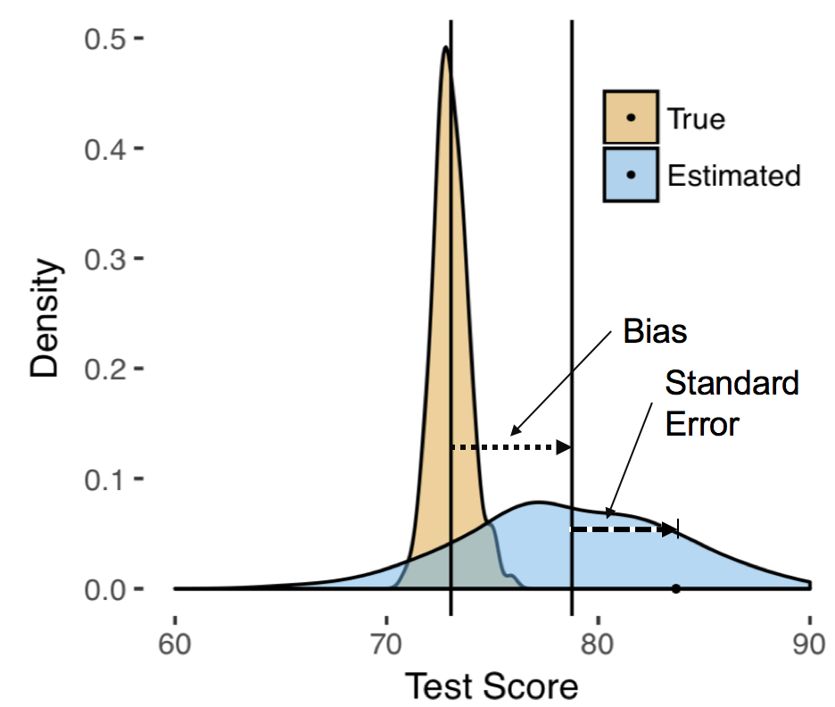
Research Questions
Compare the bias for estimates generated under MI and complete case analysis.
Bias = Truth – Estimate
”Truth” = Simulate under a known model
Notes:
Picture of darts on a bullseye.

Slide 64
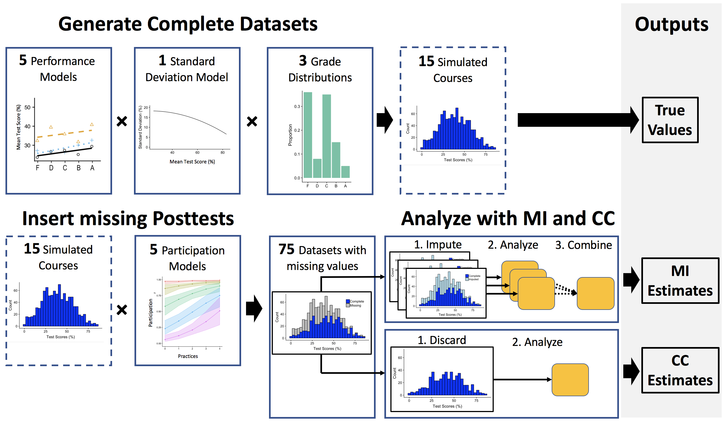
Methods
Simulated courses – N=20 times
Acted as True Values
Pretest, Posttest, and Course Grade
Examined multiple course types
3 Performance levels
3 Grade distributions

Slide 65
Results: Bias

Slide 66
Results: Bias

Slide 67
Results: Bias

Slide 68
Example: Biased Results
Compared two courses
Lecture Based
Average performance
Active Engagement
Average performance
Notes:
Complete case analysis biases the gains for everyone but much more so for the lecture based. Because it cuts out nearly all of the low performing students.
Lecturer could say: On this unbiased assessment we got the same outcome yet you are giving more A’s. You have inflated grades.

Slide 69
Example: Biased Results
Compared two courses
Lecture Based
Average performance
Low grade distribution
Low participation ~30%
Active Engagement
Average performance
High grade distribution
High participation ~80%
Notes:
Complete case analysis biases the gains for everyone but much more so for the lecture based. Because it cuts out nearly all of the low performing students.
Lecturer could say: On this unbiased assessment we got the same outcome yet you are giving more A’s. You have inflated grades.

Slide 70
Example: Biased Results
Compared two courses
Lecture Based
Average performance
Low grade distribution
Low participation ~30%
Active Engagement
Average performance
High grade distribution
High participation ~80%
Notes:
Complete case analysis biases the gains for everyone but much more so for the lecture based. Because it cuts out nearly all of the low performing students.
Lecturer could say: On this unbiased assessment we got the same outcome yet you are giving more A’s. You have inflated grades.

Slide 71
Example: Biased Results
Compared two courses
Lecture Based
Average performance
Low grade distribution
Low participation ~30%
Active Engagement
Average performance
High grade distribution
High participation ~80%
Notes:
Complete case analysis biases the gains for everyone but much more so for the lecture based. Because it cuts out nearly all of the low performing students.
Lecturer could say: On this unbiased assessment we got the same outcome yet you are giving more A’s. You have inflated grades.

Slide 72
Example: Biased Results
Compared two courses
Lecture Based
Average performance
Low grade distribution
Low participation ~30%
Active Engagement
Average performance
High grade distribution
High participation ~80%
Notes:
Complete case analysis biases the gains for everyone but much more so for the lecture based. Because it cuts out nearly all of the low performing students.
Lecturer could say: On this unbiased assessment we got the same outcome yet you are giving more A’s. You have inflated grades.

Slide 73
discussion
PER studies (among other disciplines)
often use complete case analysis
which don’t meet MCAR assumptions
and so are likely biased
Results for bias indicate
this bias may be very large
obscure differences across courses

Slide 74
Thank You
This work is funded [Ben and Jayson] in part by NSF-IUSE Grant No. DUE-1525338 and is Contribution No. LAA-059 of the Learning Assistant Alliance. We are grateful to the Learning Assistant Alliance, the Learning Assistant Program at the University of Colorado Boulder for establishing the foundation for LASSO and LASSO studies.

Slide 75
References
Stedman, L. C. (1994). The Sandia report and US achievement: An assessment. The Journal of Educational Research, 87(3), 133-146.
Miyake, A., Kost-Smith, L. E., Finkelstein, N. D., Pollock, S. J., Cohen, G. L., & Ito, T. A. (2010). Reducing the gender achievement gap in college science: A classroom study of values affirmation. Science, 330(6008), 1234-1237.
Kost-Smith, L. E., Pollock, S. J., Finkelstein, N. D., Cohen, G. L., Ito, T. A., & Miyake, A. (2012, February). Replicating a self-affirmation intervention to address gender differences: Successes and challenges. In AIP Conference Proceedings(Vol. 1413, No. 1, pp. 231-234). AIP.
Nissen, J. M., Jariwala, M., Close, E. W., & Van Dusen, B. (2018). Participation and performance on paper-and computer-based low-stakes assessments. International Journal of STEM Education, 5(1), 21.
Rubin, D. B. (1976). Inference and missing data. Biometrika, 63(3), 581-592.
Cheema, J. R. (2014). A review of missing data handling methods in education research. Review of Educational Research, 84(4), 487-508.
Schafer, J. L. (1999). Multiple imputation: a primer. Statistical methods in medical research, 8(1), 3-15.

Slide 76
Supplemental Material

Slide 77
Grade Distributions

Slide 79
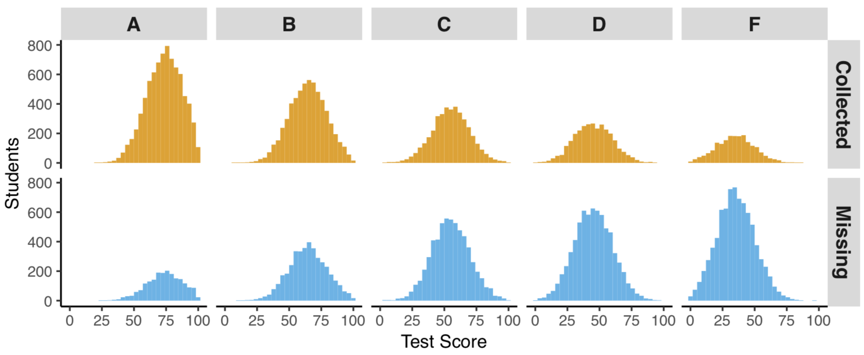

Slide 80
